Slide 1
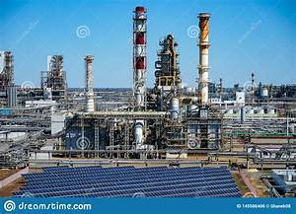

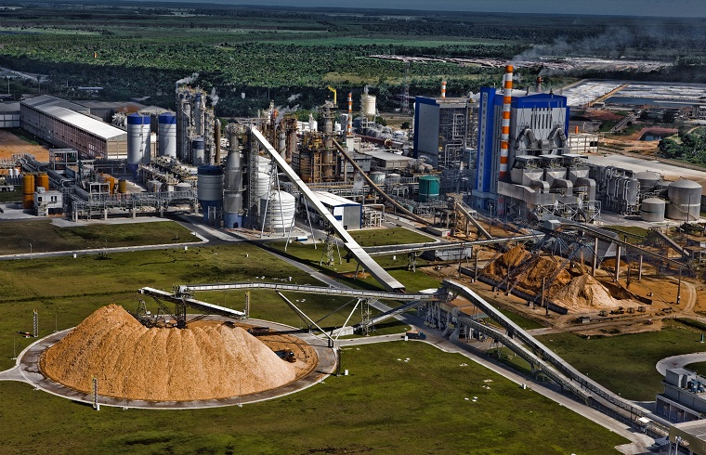
The Autonomous Mill: Utilizing Digital Twins to Optimize the Pulp & Paper Mill of the Future
Brad S. Carlberg, P.E.; Senior Control Systems Engineer
BSC Engineering Hoodsport, WA 98548
m+1 (251) 454-1200 brad.carlberg@bsc-engineering.com
1

Slide 2
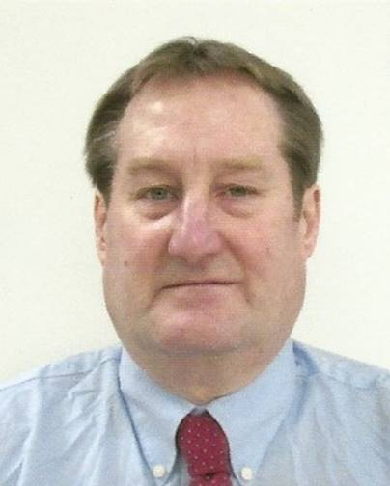
Brad S. Carlberg, P.E. (Control Systems)
Bachelor of Science in Mechanical Engineering February, 1984
Washington State University in Pullman, Washington
Registered, Professional Control Systems Engineer with over thirty - nine years’ experience
Advanced Control (APC) automation projects throughout North America in twenty-five pulp and paper mills and twenty-two petrochemical facilities.
Notes:
My Pulp & Paper career began with my 3rd grade science project in 1965 – who knew?
Then, I spent five summers while in college as a Union Summer Relief Laborer, regularly getting “moved up” to the Power mill Assistant (“Second Helper”), in the Power & Recovery Department in the Springfield, Oregon pulp & paper mill
Received his Bachelor of Science in Mechanical Engineering in February, 1984 from Washington State University in Pullman, Washington
A Registered, Professional Control Systems Engineer with over thirty - seven years’ experience in:
Process Engineering and Process Control specifically with Distributed Control Systems and Programmable Logic Controllers
combining extensive experience with both Hardware and Software Design, Programming, Implementation and Startup,
including Advanced Continuous and Batch Control Programming;
designing, implementing, and commissioning brownfield & greenfield DCS and
Advanced Control (APC) automation projects throughout North America in twenty-five pulp and paper mills and twenty-two petrochemical facilities.

Slide 3
Lessons learned:
What is an Autonomous Mill?
What is a Digital Twin?
understand the equipment and the processes in a Pulp & Paper Mill
understand the similarities to other industries
understand specific areas where control system optimization can decrease costs and/or increase production
Index Terms
Autonomous Mill, Digital Twin, Advanced Process Control (APC), Model-Based Predictive Control (MPC), modelling, optimize, automation, control loops, P&ID, virtual mill, basis weight, black liquor, bleach mill, causticizer, consistency, digester, dilution factor, evaporators, freeness, green liquor, headbox, Kappa Number, lime kiln, paper, pulp, recovery boiler, refiner, screening, sootblower, washing, white liquor, woodyard.
3

Slide 4
I. INTRODUCTION
Our Definition of The Autonomous Mill
4
Notes:
I will attempt to give you a roadmap to how to arrive at The Autonomous Mill
I would approach it by picking an area (say the digester or evaporators for example) and show how from equipment, instrumentation, and advanced control how things are run at a typical mill now.
Then introduce how advanced control has improved things and how a dynamic model has been used to design, checkout the control logic and train operators.
The next logical step (for a model) is to be used to assist when instruments fail by providing a digital twin of the instrumented signal (soft sensor).
This capability allows the mill area to move toward continuous and error free automation.
Once continuous automation is achieved for one mill area, then operators are freed to observe more and intervene less, in the same manner that pilots are more dependent on automatic control of their aircraft than a generation ago.
Thus can be achieved in a single mill area, then eventually multiple mill areas.
For the foreseeable future there will need to be operators in a mill; but by utilizing advanced control coupled with digital twin technology, mill operators will trend toward less direct intervention to a more supervisory role as trust is gained in the ability of the mill to become more autonomous.

Slide 5
Our Definition of The Autonomous Mill
1.
a. Having the right or power of self-government (an autonomous territory)
b. Undertaken or carried on without outside control: SELF-CONTAINED an autonomous school system
2.
a. Existing or capable of existing independently an autonomous zooid
b. responding, reacting, or developing independently of the whole an autonomous growth
3. controlled by the autonomic nervous system
4. of, relating to, or marked by autonomy
Acting independently or having the freedom to do so.
synonyms: self-governing independent sovereign free self-ruling self-determining autarchic self-sufficient
5
Notes:
DICTIONARY DEFINITIONS

Slide 6
Our Definition:
The Autonomous Mill is “a pulp & paper Mill that runs itself with little or no human intervention” utilizing a Digital Twin coupling the Process Model with the Control Model
The development of the Autonomous Mill is following the same path as that of the autonomous auto.
First, smart sensors and instruments were required to reliably collect data.
Next came secure and robust communications methods to move the data from the mill floor to a control computer, and back.
And finally comes the software and human expertise to combine equipment data with data pulled from process computers (DCS) and data mined from a mill’s enterprise- wide computer (ERP) to “navigate” the best path for production and profits.
6
Notes:
FIRST:
Reliable field instrumentation (that needs maintenance & recalibration)
AND
“soft sensors” (to be compared to the mill instruments to indicate AND predict field instrumentation failures)
SECOND:
Secure, Robust, bi-directional communication
THIRD:
Transfer human expertise to the Process Model

Slide 7




II. STANDARDS
7
Notes:
Alphabet Soup!
Too Many Competing Standards!
Merge & Colaborate!
Pick One!

Slide 8
ISO
ISO TECHNICAL REPORT TR 24464 1st Edition, November 2020 [2]
ISO 23247 [3]
Automation Systems and Integration — Digital Twin Framework for Manufacturing
Part 1: Overview and general principles
Part 2: Reference architecture
Part 3: Digital representation of manufacturing elements
Part 4: Information exchange
Part 5: Digital thread for digital twin
Part 6: Digital twin composition
ISO/TC 184/SC 4 - Industrial data
ISO/TC 184/SC 4/WG 3 | Oil, Gas, Process and Power | Working group
8

Slide 9
IEC ISO/IEC 30172 & 30173:2023
Digital twin: Concepts and terminology
This document establishes terminology for digital twin (DTw) and describes concepts in the field of digital twin, including the terms and definitions of digital twin, concepts of digital twin (e.g. digital twin system context, life cycle process for digital twin, types of digital twin), functional view of digital twin, and digital twin stakeholders.
ISO/IEC TR 30172 ED1:
Digital Twin - Use cases [4]
ISO/IEC 30173 ED1:
Digital Twin - Concepts and terminology [5]
This document can be used in the development of other standards and in support of communications among diverse, interested parties or stakeholders. This document is applicable to all types of organizations (e.g. commercial enterprises, government agencies, not-for-profit organizations).
9

Slide 10
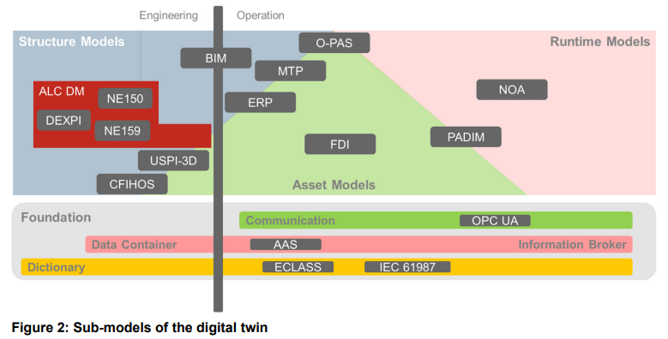
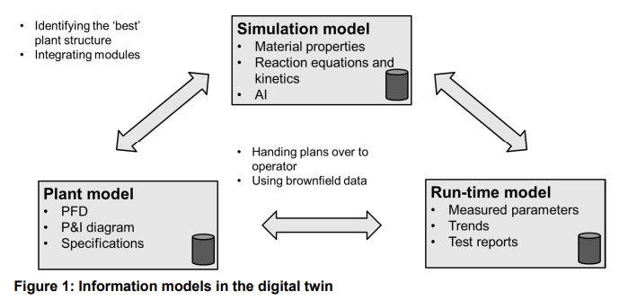
NAMUR
AK-POSITION Digital twin in process automation 2022-02-01 WG 1.3 Information management and tools
10

Slide 11
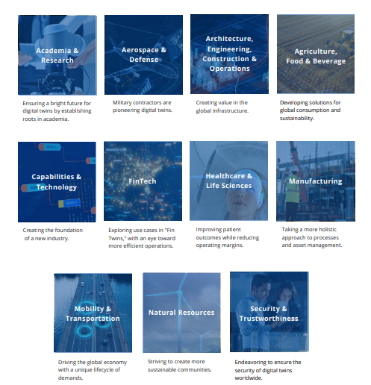
DIGITAL TWIN CONSORTIUM
The Authority in Digital Twin™ . A global ecosystem comprising industry, government, and academia.
Build and establish an extensive multi-faceted ecosystem
Identify and fill gaps in technology development
Drive interoperability through frameworks and open-source code
Develop and advocate consistent best-practice methodologies
Work to influence policy and standards requirements
Publish and amplify architectures, statements, and viewpoints
Advance scientific and technical research to expand the market
11

Slide 12
III. DEFINITION OF THE DIGITAL TWIN
12
Notes:
I will attempt to describe the several mill operations within a typical mill to reveal:
the readiness of the industry sector to move toward autonomy
2) the incentive for industry to do so
3) the steps needed to indicate the stages of parts that need to be proved or validated before going 100%, and
4) the technical problems that need to be solved (to provide guidance for the research community).

Slide 13
Digital Twin
The Digital Twin is a virtual mill, a dynamic model that contains the process, mechanical and electrical/control design information in one place.
Utilizing a dynamic model of the process, design deficiencies can be corrected.
Utilizing an advanced control loop system for optimized operation of various area, difficulties of traditional PID control are overcome by similar utilization of a model predictive controller.
First, the ability to create and embed knowledge into precompiled objects that represent common equipment
Second, to have design decisions communicated to all engineering disciplines through a database
Third, the ability to communicate via OPC (OLE for Process Control) to any control system.
The virtual mill has now changed how the process is designed
13
Notes:
The concept is that a Digital Twin (“the Virtual mill”) can provide an Autonomous mill of the Future.
Certainly this vision seems part of the Industry 4.0 vision, and Yokogawa just published their survey findings related to autonomous operation.
Three Requirements of a Digital Twin:
Intelligent blocks
Database “Cross-Reference Database” - Mapping of DCS/Digital Twin inputs and outputs (I/O Mapping) at the Staging the DCS and the Digital Twin – Step 1
Communication

Slide 14
Model Predictive Control (MPC)
provides an additional tool to improve the control of critical processes where PID or rule based expert control is not well suited to the application.
is often able to reduce process variability beyond the best performance that could be obtained with PID or expert system control methods.
can manage applications where there are delays in the process response to actuator changes or multiple interactions between process variables.
can optimize the control of processes that exhibit an integrating-type response in combination with transport delays or variable interaction.
This type of response is particularly difficult to control.
14
Notes:
Please don't lump PID with Expert System controls. PID control has been widely successful and used in 99.99% of the applications whereas I know of no long-term expert systems that provided meaningful value. certain companies wasted many millions of dollars on expert systems with no real success in the 1980s and 1990s.
Also, there is a common misconception that MPC is better than PID for dead time dominant and lag dominant systems. PID can do better than MPC at unmeasured load disturbance rejection for dead time dominant systems if you turn on external reset feedback (ERF) and put a deadtime block in the ERF path to provide dead time compensation and then tune the controller with much smaller PID reset time. PID can do better than MPC at unmeasured load disturbance rejection for lag dominant systems (process time constant greater than 4 times total loop dead time) if you use near-integrator tuning rules with an aggressive PID gain. MPC does better than PID for measured disturbances, constraint control, interactions, complex dynamics, and multivariable optimization.
If you use MPC, you should be concerned about being able to update model dead time online for transportation delays and other variable sources of dead time. Also, if you don't have PID flow loops, and directly manipulate valves, you will be subject to pressure disturbances and valve nonlinearities. You will need signal characterization to linearize valves. Reliable and accurate measurements are needed for all controlled, disturbance, and constraint variables. Precise valves are needed for all manipulated variables.
Someone needs to monitor and continuously improve MPC to handle changing conditions and deterioration in equipment, sensors, and valves.
Honeywell proposed a "lights out mill" (no operators) back in the 1970s when it first came out with its DCS. It never happened. I look at automation as not completely eliminating operators in a complex mill but elevating the role of an operator to the point of being a technician or engineer with control system expertise.

Slide 15
The Virtual mill
The virtual mill concept unites the engineering disciplines and enables process and control designs to be tested prior to start-up.
Model Predictive Control has been shown to provide additional production and improved operability.
A digital twin is an up-to-date representation, a model, of an actual physical asset in operation.
It reflects the current asset condition and includes relevant historical data about the asset.
Digital twins can be used to evaluate the current condition of the asset, and more importantly, predict future behavior, refine the control, or optimize operation.
15
Notes:
Five features of the Virtual mill

Slide 16
A Digital Twin consists of several key elements and features:
1. A virtual, dynamic model of the process.
2. The model is initialized based on the original design and is updated during procurement (vendor data), construction (as‐builts), precommissioning, commissioning, start‐up, and operations to stay aligned with the physical asset.
3. The physical asset is instrumented with sensors which can capture its current operational state.
“A digital twin allows analysis of data and system monitoring in a way that dramatically improves operations, preventing downtime, reducing maintenance costs, and providing data that can be used to streamline operations throughout the lifecycle of the asset.”
16
Notes:
Three key elements and features

Slide 17
Digital Twins: summarized in three categories
Digital Twins require process models that are dynamic and real-time. The characteristics of process models can be summarized in three categories:
1. Steady-State models are used for mill equipment sizing and process design. Inputs to these models are pressures, temperatures, flows, and compositions; and outputs are equipment sizing and process optimizations. These models can be very complex (or high fidelity), but a steady-state model does not simulate transitions between process states including time delays, deadtimes, or mass holdups.
2. Dynamic models use equipment sizes and specifications for inputs with outputs of pressures, temperatures, levels, flows, and compositions. They are time based and resolve transitions between process states. Outputs to the model are affected by the inputs along with the time delays and deadtimes of the model. Holdups and mass are calculated with the result of a dynamic material, energy, and momentum balance.
3. Real-time models are a sub-set of dynamic process models. A real-time model must converge or resolve at a fast enough cycle to allow updates to the control loops and operator console identical to the real mill.
17
Notes:
Three Categories:
Steady-State models LOW- OR HIGH-FIDELITY
Dynamic models TIME BASED
Real-time models MUST CONVERGE

Slide 18
IV. CREATING DYNAMIC PROCESS MODELS
18
Notes:
some things need to be solved and demonstrated to be industrially practicable
steady-state and transient state ID in nonlinear and noisy processes, operator and engineering training
how to adapt the first-principles models to the reality of the mill (changes in HX fouling, reactivity, raw material, impurity, piping reconfiguration, etc.)
robustness of the in-mill computing system
methods for assessing and including constraints, segregating unit models so that they can be independently used or not, and
integrating unit models for feedforward, optimizing nonlinear discrete uncertain systems, including safety,

Slide 19
CREATING DYNAMIC PROCESS MODELS
The tasks of creating dynamic process models for the individual areas of a world-class Pulp & Paper Mill can be challenging;
the ability to import and export the actual control system configuration to-and-from the Digital Twin allowed not only a comprehensive check-out of the process models,
but also verification of the process control strategy and the application programming composed to implement it. [11]
19
Notes:
[11] André Luis Bogo & Patrícia Nunes, Aracruz Celulose S.A., Espirito Santo, Brasil; Gabriel Hidalgo; IDEAS Simulation, Inc.; Vancouver, Canada; and Donald Wayne Herschmiller Veracel Celulose S.A., São Paulo, Brasil; “Aracruz Uses a Dynamic Simulator for control system Staging and Operator Training”.

Slide 20
The Operator Workstation
uses the same operator-interface graphics as in the real mill.
the operator has full use of the same screens that are used in the real mill.
DCS Configuration
The Digital Twin software and hardware are used to emulate the DCS configuration, the control models, again exactly as it will be run in the field;
and the virtual signals upon which the emulated DCS configuration code acts are generated by the process models.
20
Notes:
Open Process Automation Forum (OPAF) will simplify the automation systems of the future

Slide 21
DEVELOPMENT OF THE PROCESS MODELS
The Digital Twin uses first principles equations to calculate mass, energy, and momentum balances across multi-component systems.
Appropriately programmed, models can predict the operating characteristics of the process and track variables of interest.
One particularly valuable feature of the modeling software is its ability to interface directly with most distributed control systems.
An Object Library is a repository for a group of pre-programmed objects.
21
Notes:
The Object Library REQUIRES human expertise to build the objects

Slide 22
DEVELOPMENT OF THE PROCESS MODELS – STEP 1
Mapping of DCS/Digital Twin inputs and outputs (I/O Mapping)
On the Digital Twin side, the first step executed is the mapping into the system of all DCS inputs and outputs. In this step, each I/O device in the process model and the matching entities in the DCS configuration must be aligned.
The product of this activity is called the "Cross-Reference Database". The model developer accomplishes this activity, as the onus is on him to match the DCS system, not the other way around.
The modeler needs only support from a DCS technician in obtaining an appropriate DCS configuration Backup. At this stage, the DCS configuration does not have to be a highly developed one.
With his “Cross-Reference Database” assembled, the model developer could appear at staging perhaps three days before the finish of the conventional DCS contractor’s FAT, for a final pre-check of process model-DCS communications.
22

Slide 23
DEVELOPMENT OF THE PROCESS MODELS – STEP 2
Verification of the individual control loops; verification of configuration coding.
The model developer must have the support of a DCS technician, for adjustment of control parameters, including all features such as group starts and sequencing from the DCS side, individual control loops were tested, by trying to start the area.
Motor start/stops also were tested and controllers pre-tuned.
Modeling corrections or changes take a more detailed look at the control philosophy, interlock strategies.
23

Slide 24
DEVELOPMENT OF THE PROCESS MODELS – STEP 3
Verification of the EPC operating procedures and final validation of the process models identified mistakes in DCS configuration coding; modeling errors or suggested changes; control strategy errors or suggested changes in philosophy
A DCS configuration which could start the “virtual mill” was considered highly likely to be a configuration which would start the real mill.
The virtual mill (in essence a dynamic process model, an area DCS control configuration and an array of supporting hardware and software) was at this point ready to be applied to operator training.
Once the dynamic process model, or Virtual Pulp & Paper Mill, is built in the Digital Twin Software;
the planned Pulp & Paper Mill behavior is analyzed over a range of pulp quality parameters, production rates, and operational settings and constraints.
The Virtual Pulp & Paper Mill helped discover dynamic system behavior problems, including process control issues.
24
Notes:
identified coding mistakes, modeling errors, control strategy errors
Final Startup DCS configuration
Virtual mill for operator training
dynamic process model, or Virtual Pulp & Paper Mill, is built in the Digital Twin Software
behavior is analyzed
Virtual Pulp & Paper Mill discover dynamic system behavior problems & process control issues

Slide 25
DATA REQUIRED FOR THE MODEL BUILDING
Process flow diagrams (PFDs)
Piping and instrumentation diagrams (P&IDs)
Process design criteria
Process description
Process control philosophy
Mechanical equipment list
mill plans and raw material delivery schedules
Process quality data
Equipment elevations and layouts
Pump and control valve data sheets, and other equipment specifications
Piping line lengths and resistances (orthogonal drawings)
25

Slide 26
NEXT STEPS
The next step is to run the Digital Twin, just as a real mill can be run, through startup sequences, production rate changes, raw material (chips, pulp, ore, etc.) changes, etc. to determine how the mill will behave, dynamically, during such changes.
The models were already highly developed and were ‘run’ to simulate process operation in faster-than-real time;
where the engineer discovered process problems in the Virtual Pulp & Paper Mill, would confer with the process engineer(s) to help investigate problem & then correct the problem in the real mill.
With the Digital Twin and the Process Model, coupled with the DCS and the Control Model;
the behavior of the Autonomous Mill can be analyzed over a range of production rates, operational settings, and constraints;
key process design assumptions and decisions, could be made clear and the Autonomous Mill can be optimized.
26

Slide 27
ADVANTAGES OF MPC
Figure 1 shows an MPC controller for process with two inputs and one output in a form that allows one to see the analogy was a typical feedback control loop process that has:
    a manipulated variable MV
    a disturbance variable DV on the input
    a controlled variable CV on the output
a simple MPC controller used in this configuration has three basic components:
    a process model that predicts processor output
    a future trajectory of the set point
    and a control algorithm for computing the control action based on error
Because the impact of each manipulated input parameter on each controlled output grammar is identified by the step response model used in MPC blocked generation the MPC block automatic compensates for any interactions.
27
Notes:
Please don't lump PID with Expert System controls. PID control has been widely successful and used in 99.99% of the applications whereas I know of no long-term expert systems that provided meaningful value. certain companies wasted many millions of dollars on expert systems with no real success in the 1980s and 1990s.
Also, there is a common misconception that MPC is better than PID for dead time dominant and lag dominant systems. PID can do better than MPC at unmeasured load disturbance rejection for dead time dominant systems if you turn on external reset feedback (ERF) and put a deadtime block in the ERF path to provide dead time compensation and then tune the controller with much smaller PID reset time. PID can do better than MPC at unmeasured load disturbance rejection for lag dominant systems (process time constant greater than 4 times total loop dead time) if you use near-integrator tuning rules with an aggressive PID gain. MPC does better than PID for measured disturbances, constraint control, interactions, complex dynamics, and multivariable optimization.
If you use MPC, you should be concerned about being able to update model dead time online for transportation delays and other variable sources of dead time. Also, if you don't have PID flow loops, and directly manipulate valves, you will be subject to pressure disturbances and valve nonlinearities. You will need signal characterization to linearize valves. Reliable and accurate measurements are needed for all controlled, disturbance, and constraint variables. Precise valves are needed for all manipulated variables.
Someone needs to monitor and continuously improve MPC to handle changing conditions and deterioration in equipment, sensors, and valves.
Honeywell proposed a "lights out mill" (no operators) back in the 1970s when it first came out with its DCS. It never happened. I look at automation as not completely eliminating operators in a complex mill but elevating the role of an operator to the point of being a technician or engineer with control system expertise.

Slide 28
MPC Controller Operation Principle
manipulated variable MV (the output)
disturbance variable DV
act on the controlled variable CV (the input).
28
Notes:
Figure 1 - MPC Controller Operation Principle [25]
[25] Terence Blevins, Willy K. Wojsznis, & Mark Nixon; "Advanced Control Foundation: Tools, Techniques and Applications"; ISA; 2013; ISBN: 978-1-937560- 55-3
Figure 1 shows us an MPC controller for process with two inputs and one output in a form that allows one to see the analogy was a typical feedback control loop process has a manipulated variable MV and a disturbance variable DV on the input in a controlled variable CV on the output a simple MPC controller used in this configuration has three basic components process model that predicts processor output a future trajectory of the set point and a control algorithm for computing the control action based on error
The synergy in the digital twin of a dynamic process simulation and model predictive control (MPC) is considerable. I think you should realize that Procedural Automation and State Based Control may be needed to handle startups, shutdowns and abnormal situations addressed in the ISA TR106 and explained in the following Control Talk Column with Dustin Beebe:
Continuous improvement of continuous processes (controlglobal.com)
Continuous improvement of continuous processes
How ISA106 and procedural automation work to extend the benefits of batch standardization to continuous operations.
www.controlglobal.com

Slide 29
MPC Implementation for Interactive Processes
Because the impact of each manipulated input parameter on each controlled output grammar is identified by the step response model used in MPC blocked generation the MPC block automatic compensates for any interactions. [25]
The MPC block and its connections to associated input and output blocks are shown in Figure 2.
29
Notes:
Figure 2 - MPC Implementation for Interactive Processes [25]
[25] Terence Blevins, Willy K. Wojsznis, & Mark Nixon; "Advanced Control Foundation: Tools, Techniques and Applications"; ISA; 2013; ISBN: 978-1-937560- 55-3

Slide 30
V. OPTIMIZATION OPPORTUNITIES IN THE PULP AND PAPER MILL
30

Slide 31
OPTIMIZATION OPPORTUNITIES
IN THE PULP AND PAPER MILL
Multitudes of careers have been spent understanding and refining the pulp and paper industry and textbooks and technical papers too numerous to list have been written about the various processes and equipment in a pulp and paper mill.
There are many opportunities for optimization, either involving energy savings, chemical saving, and/or increases in production rate, of the processes throughout the pulp and paper mill.
Several examples will be described in the paragraphs to follow.
31

Slide 32
PULP & PAPER PROCESS OVERVIEW
Woodyard
Digester
Washer
Bleach
mill
Weak
Black Liq
Pulp Mill Hot Buttons:
Wood Supply
Causticizing operation
Digester/Washer
Production
Air Pollution
Water Pollution
Pulp Quality
Chemical and Energy use
Maintenance
White
Liquor
Evaporator
Paper
Mill
Converting
& Finishing
Strong
Black Liq
Causticizing
Green
Liquor
Dissolving
Tank
Recovery
Boiler
Effluent
Treatment
Lime Kiln
32

Slide 33
The Typical Pulp & Paper Mill
There are six main “islands” of automation of the mill:
    raw material receiving & preparation (the woodyard)
    the pulp mill
    the powerhouse
    the paper mill
    converting and finishing
    effluent treatment.
33

Slide 34
OPTIMIZATION OPPORTUNITIES
IN THE PULP & PAPER MILL`
RECOVERY BOILER SOOTBLOWING
BLACK LIQUOR EVAPORATORS
CAUSTICIZING
BATCH AND CONTINUOUS DIGESTERS
SCREENING AND REFINING
WASHING
BLEACHING
LIME KILN
PULP STOCK PREPARATION, CLEANING, REFINING, AND BLENDING
PAPER PAPERMAKING, PRESSING AND DRYING SECTIONS OF THE PAPER MILL
34

Slide 35
Recovery Boiler Automation
The Recovery boiler can be optimized to adjust for the continual variability in Black Liquor BTU value and compensate for changes in boiler load.
When the effects of liquor BTU and boiler load variations are eliminated, all parameters associated with the recovery process becomes more stable and the boiler can typically be operated with a higher throughput, better efficiency, improved green liquor reduction, minimized fouling, and reduced emissions.
35

Slide 36
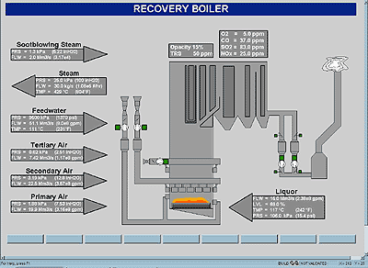
Recovery Boiler DCS Operator Graphic
When compared to a traditional control strategy, this system can provide the following benefits to mill recovery operations:
5-15% increase in black liquor throughput
1-2% increase in thermal efficiency
Improved reduction efficiency
Reduced water wash frequency
Improved environmental compliance
Reduced variability in all process parameters
Automatic control virtually at all times
Consistent boiler operation throughout all shifts
36
Notes:
Figure 3- Recovery Boiler DCS Operator Graphic
Recovery Boiler Automation [15]
[15] CyberBOILER™ Recovery Power Boiler Optimization System Functional Specification for Recovery Boiler at Mead Coated Board, Inc. Mahrt Mill Cottonton, Alabama by Orion CEM, Inc.
The Recovery boiler can be optimized to adjust for the continual variability in Black Liquor BTU value and compensate for changes in boiler load. When the effects of liquor BTU and boiler load variations are eliminated, all parameters associated with the recovery process becomes more stable and the boiler can typically be operated with a higher throughput, better efficiency, improved green liquor reduction, minimized fouling, and reduced emissions. When compared to a traditional control strategy, this system can provide the following benefits to mill recovery operations:
5-15% increase in black liquor throughput
1-2% increase in thermal efficiency
Improved reduction efficiency
Reduced water wash frequency
Improved environmental compliance
Reduced variability in all process parameters
Automatic control virtually at all times
Consistent boiler operation throughout all shifts

Slide 37
Powerhouse mill Master Control
By applying adaptive control, the mill master controller tuning can be modified to automatically compensate for the number of swing boilers on-line.
37
Notes:
Figure 4- Powerhouse mill Master [25]
[25] Terence Blevins, Willy K. Wojsznis, & Mark Nixon; "Advanced Control Foundation: Tools, Techniques and Applications"; ISA; 2013; ISBN: 978-1-937560- 55-3
The process gain associated with a loop can be impacted by the number of process units that are available to act on the PID output. An example of this is Powerhouse mill Master control, where the number of swing boilers on-line impacts the process gain associated with the main header pressure control that is provided by the mill master controller as shown in Figure 4.
By applying adaptive control, the mill master controller tuning can be modified to automatically compensate for the number of swing boilers on-line.

Slide 38
Recovery Boiler Sootblowing
As was mentioned in the first section, the Kraft Recovery Boiler utilizes steam sootblowers (usually around fifty per boiler) to blow fly ash in the combustion gases off of the boiler tunes.
Without the sootblowers, particulate would build up on the tubes effectively insulating them preventing heat transfer to the water and thereby reducing the steam output from the boiler and lowering the boiler efficiency.
To level the steam usage to the boiler the individual sootblowers are scheduled so that they operate in a predefined sequence.
Optimization of these sequences can involve using “smart sootblowing” based upon furnace draft pressures and temperatures which would signal when to blow certain regions of the tubes.
For example, if the temperature rises in a particular region, that would say that the tubes are becoming covered with soot and it would run the sootblowers in that region.
38

Slide 39
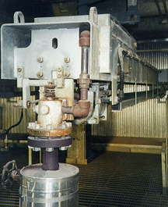
Recovery Boiler Rotary Sootblower
Uses high-pressure steam to blow soot off of boiler tubes to improve heat transfer between furnace gases and boiler water
Sequence the individual sootblower operation for optimal steam usage
Low Temp & High Diff Press signal which sections to blow
39
Notes:
Figure 5 – Recovery Boiler Sootblower
[16] Danny Tandra, and Sandeep Shah; Clyde-Bergemann, Inc. Advanced Sootblowing Strategy Using Smart Sootblower"; Atlanta, GA
[17] Dave Suplicki, Enertechnix, Maple Valley, WA; “Infrared Imaging Systems Waste to Energy Boilers"; http://www.enertechnix.com/

Slide 40
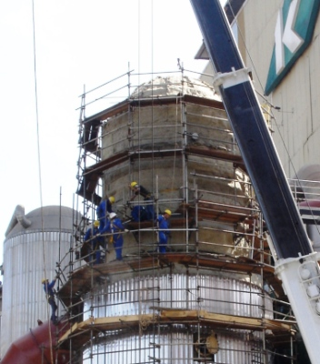
Black Liquor Evaporators
black liquor evaporators concentrate weak black liquor from the pulp washing process at around 15% to around 74% solids to burn effectively in the recovery boiler.
evaporators either packed single-column or multi-effect (up to seven). To decrease the evaporation temperature, the multi-effect units operate at a vacuum.
Fouling reduces efficiency - Automatic evaporator boilout when fouling decreases heat transfer from steam to liquor
process optimized by using pressure and temperature differential to signal tube fouling that would cause a decreased heat transfer rate and a lower vacuum
40
Notes:
Fouling reduces efficiency
Automate boilout when fouling decreases heat transfer from steam to liquor
The purpose of the black liquor evaporators is to concentrate the weak black liquor from the pulp washing process at around 15% solids to around 60% solids that will burn effectively in the recovery boiler.
The evaporators can be either a packed single-column or multi-effect (up to seven). To decrease the evaporation temperature, the multi-effect units operate at a vacuum.
The process can be optimized by using pressure and temperature differential to signal tube fouling that would cause a decreased heat transfer rate and a lower vacuum and automatically start a boilout of the evaporators to clean the fouling.

Slide 41
Multiple Effect Evaporator Process
41
Notes:
Figure 6- Multiple Effect Evaporator Process [25]
[25] Terence Blevins, Willy K. Wojsznis, & Mark Nixon; "Advanced Control Foundation: Tools, Techniques and Applications"; ISA; 2013; ISBN: 978-1-937560- 55-3

Slide 42
Multiple Effect Evaporator DCS Operator Graphic [25]
42
Notes:
Figure 7- Multiple Effect Evaporator DCS Operator Graphic [25]
[25] Terence Blevins, Willy K. Wojsznis, & Mark Nixon; "Advanced Control Foundation: Tools, Techniques and Applications"; ISA; 2013; ISBN: 978-1-937560- 55-3

Slide 43
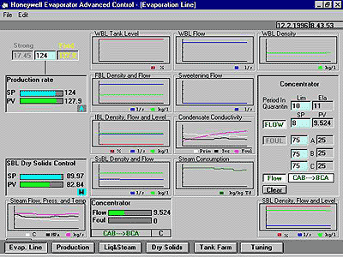
Multiple Effect Evaporator DCS Operator Graphic [25]
43
Notes:
Figure 8- Multiple Effect Evaporator DCS Operator Graphic [25]

Slide 44
Recausticizing – traditional control
Big chemical savings possible here!
Long Deadtime means Good case for Multivariable Predictive Controller
CV – Conductivity
MV – Green Liquor & Lime feeder ASDs
DV – White Liquor Production Rate
44
Notes:
Figure 9- Slaker & Causticizers
Greg McMillan says: “Please don't lump PID with Expert System controls. PID control has been widely successful and used in 99.99% of the applications whereas I know of no long-term expert systems that provided meaningful value. certain companies wasted many millions of dollars on expert systems with no real success in the 1980s and 1990s”.
Also, there is a common misconception that MPC is better than PID for dead time dominant and lag dominant systems. PID can do better than MPC at unmeasured load disturbance rejection for dead time dominant systems if you turn on external reset feedback (ERF) and put a deadtime block in the ERF path to provide dead time compensation and then tune the controller with much smaller PID reset time. PID can do better than MPC at unmeasured load disturbance rejection for lag dominant systems (process time constant greater than 4 times total loop dead time) if you use near-integrator tuning rules with an aggressive PID gain. MPC does better than PID for measured disturbances, constraint control, interactions, complex dynamics, and multivariable optimization.
If you use MPC, you should be concerned about being able to update model dead time online for transportation delays and other variable sources of dead time. Also, if you don't have PID flow loops, and directly manipulate valves, you will be subject to pressure disturbances and valve nonlinearities. You will need signal characterization to linearize valves. Reliable and accurate measurements are needed for all controlled, disturbance, and constraint variables. Precise valves are needed for all manipulated variables.
Someone needs to monitor and continuously improve MPC to handle changing conditions and deterioration in equipment, sensors, and valves.
Honeywell proposed a "lights out mill" (no operators) back in the 1970s when it first came out with its DCS. It never happened. I look at automation as not completely eliminating operators in a complex mill but elevating the role of an operator to the point of being a technician or engineer with control system expertise.

Slide 45
Recausticizing – new sensors
green liquor is reacted with lime to form the white liquor used in the wood chip digesting (cooking) process.
Traditionally, conductivity used to measure the reaction completeness.
Now, nuclear instruments can measure chemical constituents in the white liquor to better measure the reaction completeness.
causticizing process is by nature a process with a long lag time
Model-Based Predictive Control (MPC) can tune the process more tightly & yields more consistent white liquor
Big chemical savings possible here!
45
Notes:
In causticizing area of the pulp mill green liquor is reacted with lime to form the white liquor used in the wood chip digesting (cooking) process.
Traditionally, conductivity was used a variable to measure the reaction completeness. With new nuclear instruments the exact chemical constitutes in the white liquor can be determined to better gauge the reaction completeness.
Since the causticizing process is by nature a process with a long lag time and not a good candidate for traditional PID control
a new optimization technique involving using Model-Based Predictive Control (MPC) can tune the process more tightly which would yield a more consistent white liquor product.
Big chemical savings possible here!
Please don't lump PID with Expert System controls. PID control has been widely successful and used in 99.99% of the applications whereas I know of no long-term expert systems that provided meaningful value. certain companies wasted many millions of dollars on expert systems with no real success in the 1980s and 1990s.
Also, there is a common misconception that MPC is better than PID for dead time dominant and lag dominant systems. PID can do better than MPC at unmeasured load disturbance rejection for dead time dominant systems if you turn on external reset feedback (ERF) and put a deadtime block in the ERF path to provide dead time compensation and then tune the controller with much smaller PID reset time. PID can do better than MPC at unmeasured load disturbance rejection for lag dominant systems (process time constant greater than 4 times total loop dead time) if you use near-integrator tuning rules with an aggressive PID gain. MPC does better than PID for measured disturbances, constraint control, interactions, complex dynamics, and multivariable optimization.
If you use MPC, you should be concerned about being able to update model dead time online for transportation delays and other variable sources of dead time. Also, if you don't have PID flow loops, and directly manipulate valves, you will be subject to pressure disturbances and valve nonlinearities. You will need signal characterization to linearize valves. Reliable and accurate measurements are needed for all controlled, disturbance, and constraint variables. Precise valves are needed for all manipulated variables.
Someone needs to monitor and continuously improve MPC to handle changing conditions and deterioration in equipment, sensors, and valves.
Honeywell proposed a "lights out mill" (no operators) back in the 1970s when it first came out with its DCS. It never happened. I look at automation as not completely eliminating operators in a complex mill but elevating the role of an operator to the point of being a technician or engineer with control system expertise.

Slide 46
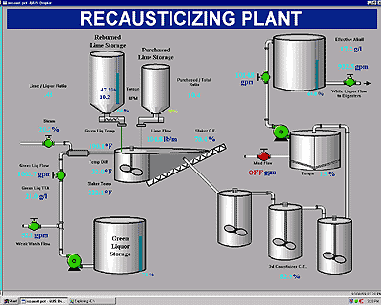
Slaker & Causticizers DCS Operator Graphic
Fig. 10 explanations:
Long Deadtime means Good case for Multivariable Predictive Controller
CV – Conductivity
MV – Green Liquor & Lime feeder ASDs
DV – White Liquor Production Rate
46
Notes:
Figure 10- Slaker & Causticizers DCS Operator Graphic
Fig. 10 explanations:
Long Deadtime means Good case for Multivariable Predictive Controller
CV – Conductivity
MV – Green Liquor & Lime feeder ASDs
DV – White Liquor Production Rate
Please don't lump PID with Expert System controls. PID control has been widely successful and used in 99.99% of the applications whereas I know of no long-term expert systems that provided meaningful value. certain companies wasted many millions of dollars on expert systems with no real success in the 1980s and 1990s.
Also, there is a common misconception that MPC is better than PID for dead time dominant and lag dominant systems. PID can do better than MPC at unmeasured load disturbance rejection for dead time dominant systems if you turn on external reset feedback (ERF) and put a deadtime block in the ERF path to provide dead time compensation and then tune the controller with much smaller PID reset time. PID can do better than MPC at unmeasured load disturbance rejection for lag dominant systems (process time constant greater than 4 times total loop dead time) if you use near-integrator tuning rules with an aggressive PID gain. MPC does better than PID for measured disturbances, constraint control, interactions, complex dynamics, and multivariable optimization.
If you use MPC, you should be concerned about being able to update model dead time online for transportation delays and other variable sources of dead time. Also, if you don't have PID flow loops, and directly manipulate valves, you will be subject to pressure disturbances and valve nonlinearities. You will need signal characterization to linearize valves. Reliable and accurate measurements are needed for all controlled, disturbance, and constraint variables. Precise valves are needed for all manipulated variables.
Someone needs to monitor and continuously improve MPC to handle changing conditions and deterioration in equipment, sensors, and valves.
Honeywell proposed a "lights out mill" (no operators) back in the 1970s when it first came out with its DCS. It never happened. I look at automation as not completely eliminating operators in a complex mill but elevating the role of an operator to the point of being a technician or engineer with control system expertise.

Slide 47
Batch & Continuous Digesters
wood chips, cooking chemicals, & steam added to the digester at an elevated pressure and temperature
either/or batch or continuous digesters.
the wood chips are cooked (really “exploded”) for sixty to ninety minutes.
pulp stock slurry exits digester at a of 6% consistency
energy savings by increasing throughput and batch scheduling
Leveling steam consumption reduces fluctuations in the boiler demand.
freeness (a measure of the cooking completeness)
online analyzers can close the control loop to more accurately determine when the cook is complete.
47
Notes:
Figure 11- Continuous Digester Process [25]
[25] Terence Blevins, Willy K. Wojsznis, & Mark Nixon; "Advanced Control Foundation: Tools, Techniques and Applications"; ISA; 2013; ISBN: 978-1-937560- 55-3
The chip meter speed sets the digester production rate. The Kappa number can be measured using an online analyzer or by analyzing the grab sample in the lab. The delay associated with each input that is reflected in the Kappa number is automatically determined by doing cross correlation between the process inputs and the Kappa number. [25]
The pulp digesting (cooking) process uses either/or batch or continuous digesters.
Either way, the principle is the same; the wood chips and the cooking chemicals are added to the digester and under pressure and at an elevated temperature from the steam addition,
the wood chips are cooked (really “exploded”) for sixty to ninety minutes.
The pulp stock slurry exits the digester at a consistency of 6% and the resulting pulp fibers are close to the state they need to be in to make the paper.
The optimization here can involve energy savings by increasing throughput and scheduling the batches so that steam consumption is leveled so that spikes cause fluctuations in the boiler demand.
Also, online freeness (a measure of the cooking completeness) analyzers can close the control loop to more accurately determine when the cook is complete.
Please don't lump PID with Expert System controls. PID control has been widely successful and used in 99.99% of the applications whereas I know of no long-term expert systems that provided meaningful value. certain companies wasted many millions of dollars on expert systems with no real success in the 1980s and 1990s.
Also, there is a common misconception that MPC is better than PID for dead time dominant and lag dominant systems. PID can do better than MPC at unmeasured load disturbance rejection for dead time dominant systems if you turn on external reset feedback (ERF) and put a deadtime block in the ERF path to provide dead time compensation and then tune the controller with much smaller PID reset time. PID can do better than MPC at unmeasured load disturbance rejection for lag dominant systems (process time constant greater than 4 times total loop dead time) if you use near-integrator tuning rules with an aggressive PID gain. MPC does better than PID for measured disturbances, constraint control, interactions, complex dynamics, and multivariable optimization.
If you use MPC, you should be concerned about being able to update model dead time online for transportation delays and other variable sources of dead time. Also, if you don't have PID flow loops, and directly manipulate valves, you will be subject to pressure disturbances and valve nonlinearities. You will need signal characterization to linearize valves. Reliable and accurate measurements are needed for all controlled, disturbance, and constraint variables. Precise valves are needed for all manipulated variables.
Someone needs to monitor and continuously improve MPC to handle changing conditions and deterioration in equipment, sensors, and valves.
Honeywell proposed a "lights out mill" (no operators) back in the 1970s when it first came out with its DCS. It never happened. I look at automation as not completely eliminating operators in a complex mill but elevating the role of an operator to the point of being a technician or engineer with control system expertise.

Slide 48
Continuous Digester DCS Operator Graphic [25]
Fig. 12, 13, & 14 explanations
Kappa Number is the amount of delignification of the pulp fiber
For example, brown board will have a higher Kappa Number than bleached pulp
White Liquor Analyzer to sense residual chemical
Kappa Analyzer to sense fiber delignification
Batch Scheduling - Steam Leveling smoothes boiler operation
Chip Qualities – uniform moisture
Batch digesters- liquor analyzer
Better Kappa control
Reduce white liquor usage
Batch digesters- Kappa analyzer
Better Kappa control
48
Notes:
Figure 12- Continuous Digester DCS Operator Graphic [25]
Fig. 12, 13, & 14 explanations
Kappa Number is the amount of delignification of the pulp fiber
For example, brown board will have a higher Kappa Number than bleached pulp
White Liquor Analyzer to sense residual chemical
Kappa Analyzer to sense fiber delignification
Batch Scheduling - Steam Leveling smoothes boiler operation
Chip Qualities – uniform moisture
Batch digesters- liquor analyzer
Better Kappa control
Reduce white liquor usage
Batch digesters- Kappa analyzer
Better Kappa control

Slide 49
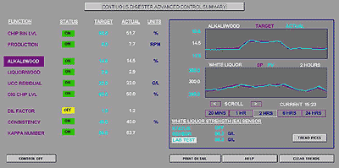
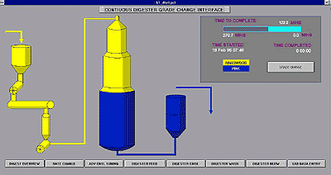
Continuous Digester Advanced Control Summary & Grade Change
Kappa Number is the amount of delignification of the pulp fiber
For example, brown board will have a higher Kappa Number than bleached pulp
White Liquor Analyzer to sense residual chemical
Kappa Analyzer to sense fiber delignification
49
Notes:
Figure 13 Continuous Digester Advanced Control Summary
Figure 14 Continuous Digester Grade Change

Slide 50
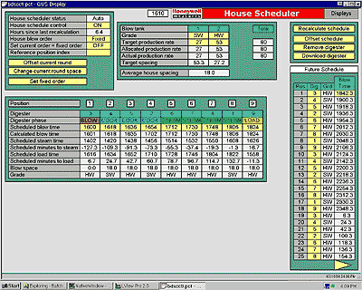
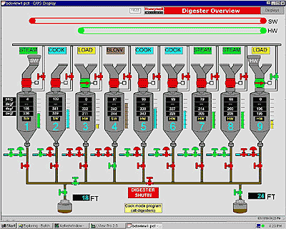
Batch Digester Overview & House Scheduler
Batch Scheduling - Steam Leveling smoothes boiler operation
Chip Qualities – uniform moisture
Batch digesters- liquor analyzer
Better Kappa control
Reduce white liquor usage
Batch digesters- Kappa analyzer
Better Kappa control
Figure 15- Batch Digester Overview [19] Figure 16- Batch Digester House Scheduler [19]
Harris Mayeaux and Kathy Hutson
50
Notes:
Figure 15- Batch Digester Overview
Figure 16- Batch Digester House Scheduler
[19] Harris Mayeaux and Kathy Hutson; "Advanced Controls at CCA Brewton Provide Stable Fiberline Operation"; Pulp & Paper Magazine; April 1, 1996

Slide 51
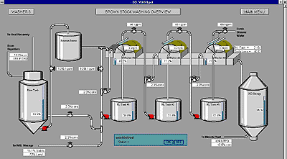
Brown Stock Washer Overview
brown stock is still dirty from lignin, “glue” that binds fibers and gives the wood its strength and rigidity & organic and inorganic byproducts from the digesting process
weak black liquor around 15% solids. & burn 74% strong black liquor in recovery boiler.
inorganic cooking chemicals reused in the digestor
multiple (three), countercurrent, pulp one direction & clean wash water opposite direction)
Fresh water added to cleanest pulp
recycled weak liquor added to dirtiest pulp
Optimum Dilution Factor = 1.0 means that (Lbs water = lbs pulp)
(pounds wash water / pounds wood fiber)
Less wash water reduces the load on the evaporators i.e. less steam usage
51
Notes:
Figure 17- Brown Stock Washer Overview
The digested, screened, and perhaps refined pulp stock, although uniform in fiber size, is still very dirty with all the by organic and inorganic byproducts from the digesting process, known as weak black liquor at around 15% solids.
The dark color comes primarily from the lignin which is the “glue” that binds the wood fibers and gives the wood its strength and rigidity. There are also a lot of residual cooking inorganic chemicals that can be reused in the digesting process.
The brown stock washers usually consistent of multiple (three), countercurrent (which means pulp stock comes from one direction and clean wash water comes from the opposite direction) stages.
Fresh make-up wash water is added on the cleanest pulp at the latter stages to wash the pulp stock, but the recycled weak liquor wash water is added on the dirtiest pulp at the earlier stages.
A common optimization technique is to use Dilution Factor Washing based on pounds of wash water to pounds of wood fiber (the optimal ratio is about 1.0) to minimize overwashing that would use more water that would subsequently need to be evaporated to get the black liquor to the magic number of 65% for burning in the recovery boiler.

Slide 52
Bleaching
The decision whether to bleach the pulp is based on the final product of the paper mill. If the product is cardboard or paper sacks, bleaching is probably unnecessary. But if the product is writing paper, paper towels, tissue, diapers, etc. then the pulp will need to be bleached. The bleach mill usually consists of multiple (three to five) stage washers interspersed between bleach towers.
The predominant area for savings in the bleach mill is to optimize the chemical usage by utilizing techniques something like KAPPA Factor bleaching and stock tracking throughout the bleaching stages to apply bleaching chemical based on a precise ratio of pounds of effective chlorine to the pounds of fiber.
As with the causticizer, the bleaching process is by nature a process with a long lag time and not a good candidate for traditional PID control; a new optimization technique involving using Model-Based Predictive Control (MPC), can tune the process more tightly which would yield a more consistently bleached pulp.
52
Notes:
The decision whether to bleach the pulp is based on the final product of the paper mill. If the product is cardboard or paper sacks, bleaching is probably unnecessary. But if the product is writing paper, paper towels, tissue, diapers, etc. then the pulp will need to be bleached. The bleach mill usually consists of multiple (three to five) stage washers interspersed between bleach towers.
Typically, bleaching chemicals are liquid or gaseous chlorine, chlorine dioxide, sodium hydroxide, sodium hypochlorite, hydrogen peroxide, liquid or gaseous oxygen, and liquid or gaseous ozone. These bleaching towers allow the resident time (usually one to three hours per tower) for the bleaching chemicals to brighten and whiten the pulp.
The predominant area for savings in the bleach mill is to optimize the chemical usage by utilizing techniques something like KAPPA Factor bleaching and stock tracking throughout the bleaching stages to apply bleaching chemical based on a precise ratio of pounds of effective chlorine to the pounds of fiber.
As with the causticizer, the bleaching process is by nature a process with a long lag time and not a good candidate for traditional PID control; a new optimization technique involving using Model-Based Predictive Control (MPC), can tune the process more tightly which would yield a more consistently bleached pulp.
Again, Long Deadtime means Good case for Multivariable Predictive Controller
Please don't lump PID with Expert System controls. PID control has been widely successful and used in 99.99% of the applications whereas I know of no long-term expert systems that provided meaningful value. certain companies wasted many millions of dollars on expert systems with no real success in the 1980s and 1990s.
Also, there is a common misconception that MPC is better than PID for dead time dominant and lag dominant systems. PID can do better than MPC at unmeasured load disturbance rejection for dead time dominant systems if you turn on external reset feedback (ERF) and put a deadtime block in the ERF path to provide dead time compensation and then tune the controller with much smaller PID reset time. PID can do better than MPC at unmeasured load disturbance rejection for lag dominant systems (process time constant greater than 4 times total loop dead time) if you use near-integrator tuning rules with an aggressive PID gain. MPC does better than PID for measured disturbances, constraint control, interactions, complex dynamics, and multivariable optimization.
If you use MPC, you should be concerned about being able to update model dead time online for transportation delays and other variable sources of dead time. Also, if you don't have PID flow loops, and directly manipulate valves, you will be subject to pressure disturbances and valve nonlinearities. You will need signal characterization to linearize valves. Reliable and accurate measurements are needed for all controlled, disturbance, and constraint variables. Precise valves are needed for all manipulated variables.
Someone needs to monitor and continuously improve MPC to handle changing conditions and deterioration in equipment, sensors, and valves.
Honeywell proposed a "lights out mill" (no operators) back in the 1970s when it first came out with its DCS. It never happened. I look at automation as not completely eliminating operators in a complex mill but elevating the role of an operator to the point of being a technician or engineer with control system expertise.

Slide 53
Impact of throughput – Bleach Tower Example
writing paper, paper towels, tissue, diapers, etc require bleached.
multiple (three to five) stage washers interspersed between bleach towers. [22] [23]
resident time (usually one to three hours
bleaching chemicals brighten and/or whiten pulp
liquid or gaseous ClO₂, ClO₂, O₂, or O₃
NaOH
NaHClO
H₂O₂
53
Notes:
Figure 18- Impact of Throughput – Bleach Tower Example [21]
liquid or gaseous chlorine (Cl2, chlorine dioxide (ClO2, oxygen (O2, or ozone (O3)
sodium hydroxide (NaOH
sodium hypochlorite (NaHClO
hydrogen peroxide (H2O2
The decision whether to bleach the pulp is based on the final product of the paper mill. If the product is cardboard or paper sacks, bleaching is probably unnecessary. But if the product is writing paper, paper towels, tissue, diapers, etc. then the pulp will need to be bleached. The bleach mill usually consists of multiple (three to five) stage washers interspersed between bleach towers. [22] [23]
Typically, bleaching chemicals are liquid or gaseous chlorine, chlorine dioxide, sodium hydroxide, sodium hypochlorite, hydrogen peroxide, liquid or gaseous oxygen, and liquid or gaseous ozone. These bleaching towers allow the resident time (usually one to three hours per tower) for the bleaching chemicals to brighten and whiten the pulp.

Slide 54
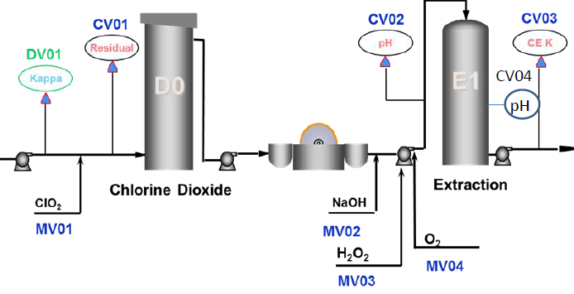
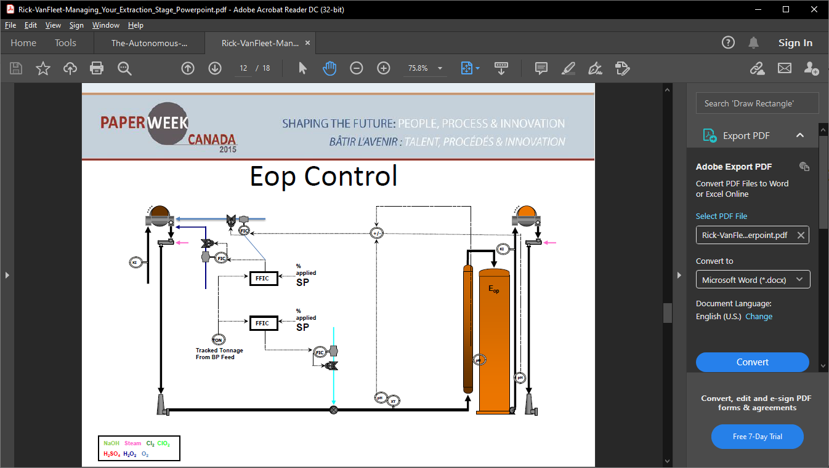
Elements of Advanced Control & EOP Control
D0 Stage
DV01 – Kappa
CV01 – ClO2 Residual CV02 – Inlet pH
CV03 – CE Kappa
CV04 – Terminal pH
EOP Stage
MV01 – ClO2 flow MV02 – NaOH flow
MV03 – H2O2 flow
MV04 – O2 flow
What are the components?
• Tonnage
• Incoming pH
• Caustic Dosage
• Caustic to TEC Ratio
54
Notes:
Figure 19 Elements of Advanced Control [18]
Figure 20 E_{OP} Control [18]
The predominant area for savings in the bleach mill is to optimize the chemical usage by utilizing techniques something like KAPPA Factor bleaching and stock tracking throughout the bleaching stages to apply bleaching chemical based on a precise ratio of pounds of effective chlorine to the pounds of fiber.
As with the causticizer, the bleaching process is by nature a process with a long lag time and not a good candidate for traditional PID control; a new optimization technique involving using Model-Based Predictive Control (MPC) [24], can tune the process more tightly which would yield a more consistently bleached pulp.
Again, Long Deadtimes suggest a good case for Multivariable Predictive Controller [21]

Slide 55
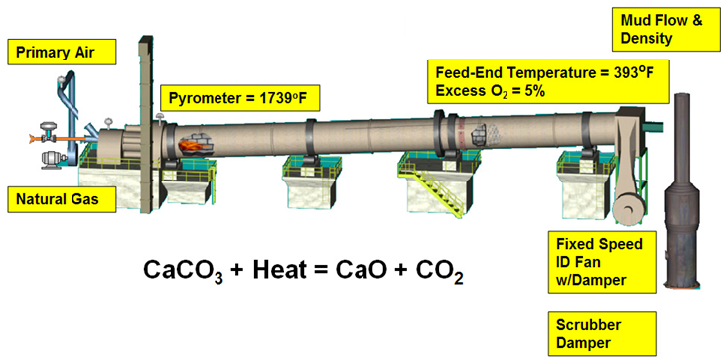
Lime Kiln
Big energy savings possible here!
55
Notes:
Figure 21- Lime Kiln Process

Slide 56
Lime Kiln Process P&ID [25]
The lime kiln is a large (15 ft diameter by 200 ft long), rotating cylinder used to calcinate the byproduct of the causticizing process, the lime mud, to convert it back to the lime that can be added in the causticizer.
The predominant area for savings is the energy (gas burned in the lime kiln) savings by optimizing the lime mud moisture content and the temperature of the calcined lime exiting the kiln.
56
Notes:
Figure 22 - Lime Kiln Process P&ID [25]
[25] Terence Blevins, Willy K. Wojsznis, & Mark Nixon; "Advanced Control Foundation: Tools, Techniques and Applications"; ISA; 2013; ISBN: 978-1-937560- 55-3

Slide 57
Lime Kiln MPC [25]
As with the causticizer and bleach mill, the Lime kiln process is by nature a process with a long lag time and not a good candidate for traditional PID control;
a new optimization technique involving using Model-Based Predictive Control (MPC) [19], can tune the process more tightly which would yield a more efficient combustion process.
57
Notes:
Figure 23- Lime Kiln MPC [25]
[25] Terence Blevins, Willy K. Wojsznis, & Mark Nixon; "Advanced Control Foundation: Tools, Techniques and Applications"; ISA; 2013; ISBN: 978-1-937560- 55-3
Please don't lump PID with Expert System controls. PID control has been widely successful and used in 99.99% of the applications whereas I know of no long-term expert systems that provided meaningful value. certain companies wasted many millions of dollars on expert systems with no real success in the 1980s and 1990s.
Also, there is a common misconception that MPC is better than PID for dead time dominant and lag dominant systems. PID can do better than MPC at unmeasured load disturbance rejection for dead time dominant systems if you turn on external reset feedback (ERF) and put a deadtime block in the ERF path to provide dead time compensation and then tune the controller with much smaller PID reset time. PID can do better than MPC at unmeasured load disturbance rejection for lag dominant systems (process time constant greater than 4 times total loop dead time) if you use near-integrator tuning rules with an aggressive PID gain. MPC does better than PID for measured disturbances, constraint control, interactions, complex dynamics, and multivariable optimization.
If you use MPC, you should be concerned about being able to update model dead time online for transportation delays and other variable sources of dead time. Also, if you don't have PID flow loops, and directly manipulate valves, you will be subject to pressure disturbances and valve nonlinearities. You will need signal characterization to linearize valves. Reliable and accurate measurements are needed for all controlled, disturbance, and constraint variables. Precise valves are needed for all manipulated variables.
Someone needs to monitor and continuously improve MPC to handle changing conditions and deterioration in equipment, sensors, and valves.
Honeywell proposed a "lights out mill" (no operators) back in the 1970s when it first came out with its DCS. It never happened. I look at automation as not completely eliminating operators in a complex mill but elevating the role of an operator to the point of being a technician or engineer with control system expertise.

Slide 58
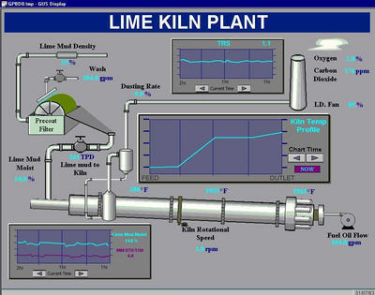
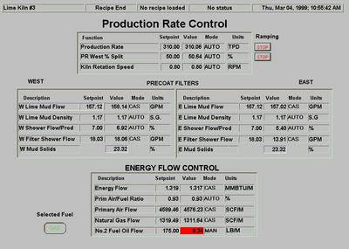
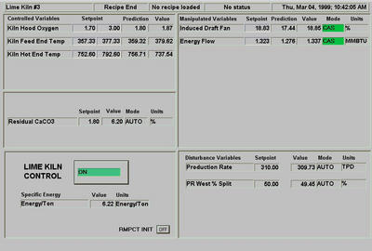
Lime Kiln DCS Operator Graphic, Advanced Control Summary, & Production Rate Control
Shown with the following variables:
Long Deadtime means Good case for Multivariable Predictive Controller
CV – Temps
MV – ID Fan ASD
DV – Production Rate
58
Notes:
Figure 24 Lime Kiln DCS Operator Graphic
Figure 25 Lime Kiln Lime Kiln Advanced Control Summary
Figure 26 Lime Kiln Production Rate Control
Please don't lump PID with Expert System controls. PID control has been widely successful and used in 99.99% of the applications whereas I know of no long-term expert systems that provided meaningful value. certain companies wasted many millions of dollars on expert systems with no real success in the 1980s and 1990s.
Also, there is a common misconception that MPC is better than PID for dead time dominant and lag dominant systems. PID can do better than MPC at unmeasured load disturbance rejection for dead time dominant systems if you turn on external reset feedback (ERF) and put a deadtime block in the ERF path to provide dead time compensation and then tune the controller with much smaller PID reset time. PID can do better than MPC at unmeasured load disturbance rejection for lag dominant systems (process time constant greater than 4 times total loop dead time) if you use near-integrator tuning rules with an aggressive PID gain. MPC does better than PID for measured disturbances, constraint control, interactions, complex dynamics, and multivariable optimization.
If you use MPC, you should be concerned about being able to update model dead time online for transportation delays and other variable sources of dead time. Also, if you don't have PID flow loops, and directly manipulate valves, you will be subject to pressure disturbances and valve nonlinearities. You will need signal characterization to linearize valves. Reliable and accurate measurements are needed for all controlled, disturbance, and constraint variables. Precise valves are needed for all manipulated variables.
Someone needs to monitor and continuously improve MPC to handle changing conditions and deterioration in equipment, sensors, and valves.
Honeywell proposed a "lights out mill" (no operators) back in the 1970s when it first came out with its DCS. It never happened. I look at automation as not completely eliminating operators in a complex mill but elevating the role of an operator to the point of being a technician or engineer with control system expertise.

Slide 59
Chemi-Thermo-Mechanical-Pulp (CTMP)
MVs | CVs
Plug screw speed | Primary motor load
Primary plate pressure | Secondary motor load
Secondary plate pressure | Canadian Standard Freeness (CSF)
Primary dilution flows (DE &TE) | Primary blow line consistency
Secondary dilution flows (DE &TE) | Secondary blow line consistency
Attenuate wood chip density variations
control pulp quality (freeness)
Minimize total applied electrical load
minimize refiner motor loads
Control blow line consistency
maximize production rate
59
Notes:
Figure 27- CMTP Refiner [25]
[25] Terence Blevins, Willy K. Wojsznis, & Mark Nixon; "Advanced Control Foundation: Tools, Techniques and Applications"; ISA; 2013; ISBN: 978-1-937560- 55-3
In order to produce high quality Chemi-Thermo-Mechanical-Pulp (CTMP) the refining process must be under tight control. Closed loop control of a mechanical refining system is one of the most complex and challenging control problems in a pulp mill. The process is inherently multivariable and exhibits strong interactions. [25]
There is a direct relationship between the specific energy (kWh per ton) and the pulp quality (freeness). This relationship is constant provided the furnished composition (wood chip mixture, bulk density, moisture, etc.) is constant for a given production rate.
The primary objectives of the MPC controllers to minimize refiner motor loads while maintaining the freeness within operator specified targets
The mainline refiners consume a significant amount of electrical energy to reduce wood chips to pulp. In fact, CTMP refiners are the single biggest consumer of electrical energy in the mill and hence present the largest opportunity for energy and cost reductions. Based on historical data, a process energy consumption model was derived. A fully centralized control strategy based on MPC using online linear programming and optimization was developed. The benefits of using the MPC based control strategy resulted in savings of $303k per year and a reduction of 25% in freeness variability.

Slide 60
PULP STOCK PREPARATION, CLEANING, REFINING, AND BLENDING
This is the area where the pulping ends and the papermaking begins.
The “art of papermaking” is in the final cleaning to remove any remaining contaminants,
in the “tickle” refining to “brush” the fibers to optimize fiber bonding in the paper sheet,
in the blending of different pulp species (hardwood and softwood), filler, additives,
to achieve the optimum paper optical, physiochemical, strength, structural, and surface properties.
60

Slide 61
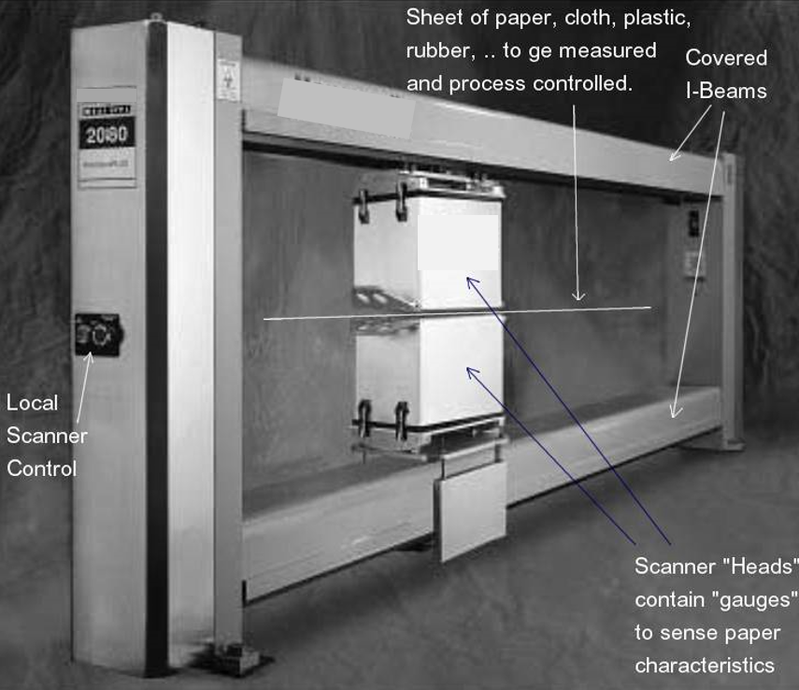
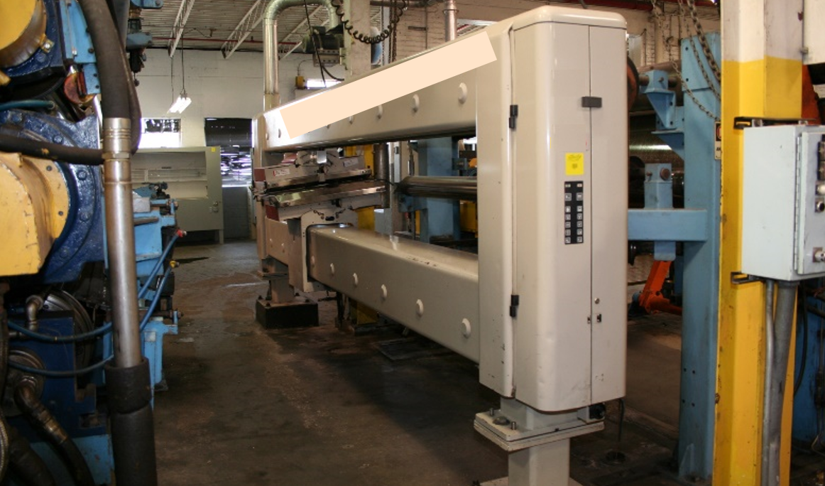
Paper Papermaking, Pressing and Drying Sections of the Paper Mill
After all the preparation of the pulp it is stored in the machine chest. From there, the fan pump pumps the pulp stock to the headbox from which the pulp stock slurry is “laid down” on the fourdrinier wire along the entire width (sometimes over 300 inches wide) of the machine via the “slice” out of the headbox.
The primary control variables in papermaking are:
basis weight
moisture
caliper (thickness)
A typical paper machine can be as long as a football field.
As in the pulp mill where the majority of the processes remove the pulping byproducts;
the majority of the paper machine removes the water from the paper in first the forming section, followed by the press section, and, finally, the dryer section.
61
Notes:
Figure 27 One Brand of Scanner Figure 28 Another Brand of Scanner

Slide 62
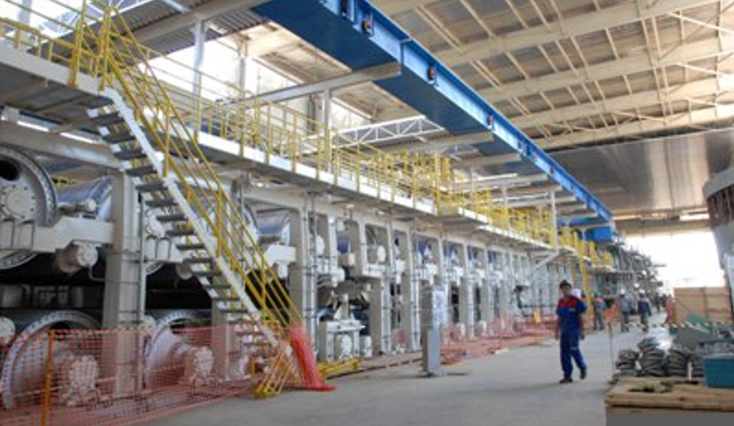
Paper Machine Dryers
steam is used to heat the sheet to evaporate moisture as it passes over “dryer can” cylinders to the “dry end”
Recently, video cameras placed at strategic points along the paper machine
very effectively used to alert the operators of events that can cause a paper sheet break.
With this information, the operator can avoid an actual sheet significantly decreasing production downtime. [30]
cascaded and coupled, variable frequency drives control fourdrinier wire, press, and dryer sections
Optimize Steam Usage
tightly regulate rush and drag
Eliminate sheet breaks
62
Notes:
Figure 29 Paper Machine Dryers
[30] Kari Hilden, of PaperTech Inc.; "Improving Papermaking and Coating Efficiency with Web Inspection Cameras"; TAPPI/PIMA Papercon 2008 Conference; Dallas, TX
The main area for savings again are those of energy savings in the dryer where steam is used to heat the “dryer cans” to heat the paper sheet as it passes over them on its way down to the “dry end” of the paper machine.
Paper sheet rolls over the steam-heated dryer cylinders to evaporate moisture
Optimize Steam Usage to save energy costs
Recently, the use of video cameras placed at strategic points along the paper machine has been very effectively used to alert the operators of events that can cause a paper sheet break. With this information, the operator can avoid an actual sheet significantly decreasing production downtime. [30]
Use of cascaded and coupled, variable frequency drives controlling the various rollers in the fourdrinier wire, press, and dryer sections can more tightly regulate the tension (rush and drag) of the paper sheet mitigating undue stresses that could cause a paper sheet break.

Slide 63
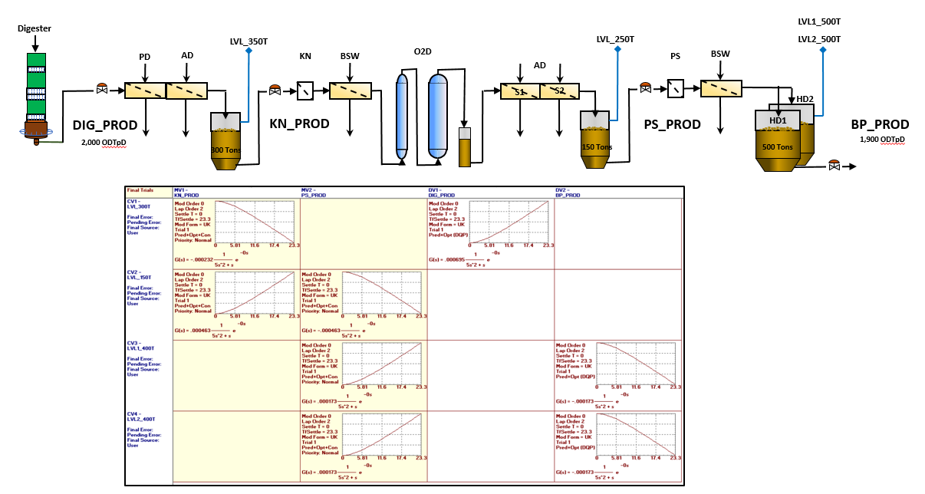
PRODUCTION RATE CONTROL:
MPC & Model Identifier [31]
CV3
CV1
CV2
CV4
MV1
MV2
DV1
DV2
Use of Production Rate control will enable the Autonomous Mill to achieve optimal performance.
Courtesy of Michel R. Dion
63
Notes:
Figure 30 Production Rate Control MPC [31]
Figure 31 Production Rate Control MPC Model Identifier [31]
[31] Michel R. Dion; Honeywell; “A practical approach for process control optimization during start-up Fiberline Process Optimization Pulp & Paper Industries”; Originally presented at the ISA@Montreal2018 Symposium at the Hyatt Regency Hotel on Tuesday, October 16, 2018
CV1 – LVL300T MV1 – KN_PROD
CV2 – LVL_150T MV2 – PS_PROD
CV3 – LVL 1_400T DV1 – DIG_PROD
CV4 – LVL 2_400T DV2 – BP_PROD

Slide 64
CONCLUSIONS
The Autonomous Mill of the future is a pulp & paper mill that benefits from the use of Digital Twins utilizing a Process Model coupled with a Control Model of the real-time Control System to allow the Autonomous Mill to “run itself” with little or no human intervention.
After reading this paper, you have an idea of several specific areas around the six “islands” of the mill where robust and well-maintained control system optimization, Advanced Process Control (APC), and Model-Based Predictive Control (MPC) can increase production, decrease costs, and autonomously operate the mill of the future.
64
Notes:
I will attempt to give you a roadmap to how to arrive at The Autonomous Mill
I would approach it by picking an area (say the digester or evaporators for example) and show how from equipment, instrumentation, and advanced control how things are run at a typical mill now.
Then introduce how advanced control has improved things and how a dynamic model has been used to design, checkout the control logic and train operators.
The next logical step (for a model) is to be used to assist when instruments fail by providing a digital twin of the instrumented signal (soft sensor).
This capability allows the mill area to move toward continuous and error free automation.
Once continuous automation is achieved for one mill area, then operators are freed to observe more and intervene less, in the same manner that pilots are more dependent on automatic control of their aircraft than a generation ago.
Thus can be achieved in a single mill area, then eventually multiple mill areas.
For the foreseeable future there will need to be operators in a P&P mill; but by utilizing advanced control coupled with digital twin technology, mill operators will trend toward less direct intervention to a more supervisory role as trust is gained in the ability of the mill to become more autonomous.
This paper is merely an overview of the unit operations and equipment common to a pulp and paper mill;
innumerable books and careers have been spent describing and learning these aspects of the control of these processes that I have endeavored to tell you about in these pages.
Hopefully, you now can find your way around the six main “islands” of automation of any pulp and paper mill: raw material receiving and preparation (the woodyard), the pulp mill, the powerhouse, the paper mill, converting and finishing, effluent treatment.
you now have a better understanding of the equipment and the processes in a pulp and paper mill; and
you can see the similarities to other industries.

Slide 65
ACKNOWLEDGEMENTS
I must acknowledge several people without whose help throughout my life and career I would not have been able to gain the necessary experience in pulp and paper mills to write this paper.
To John Lavigne, ISA Pulp and Paper Industry Division member and ISA Fellow and the author of “An Introduction to Paper Industry Instrumentation”.
To Gary Smook, British Columbia Institute of Technology instructor and author of the “Handbook for Pulp and Paper Technologists”.
To Matt McGarry, my coworker from H.A.Simons Ltd in Vancouver
To Greg McMillan, ISA Fellow, who allowed me to “pick his brain” about mimic & modelling
To Steve and Rick Van Fleet, my supervisors (and friends) and two of the brightest pulp and paper minds I have ever met
And finally, saving the best for last, to my Dad, Gary
65
Notes:
I must acknowledge several people without whose help throughout my life and career I would not have been able to gain the necessary experience in pulp and paper mills to write this paper.
To John Lavigne, ISA Pulp and Paper Industry Division member and ISA Fellow and the author of “An Introduction to Paper Industry Instrumentation”, for writing the book I read when I was new graduate Mechanical Engineer fresh out of school.
To Gary Smook, British Columbia Institute of Technology instructor and author of the “Handbook for Pulp and Paper Technologists”, for developing the 14-week course taught after work at H.A. Simons Ltd offices in Vancouver.
To Matt McGarry, my coworker from H.A.Simons Ltd in Vancouver, who allowed me to “pick his brain” about IDEAS Simulation & later about Digital Twins.
To Greg McMillan, ISA Fellow, who allowed me to “pick his brain” about mimic, DeltaV, & modelling, and for being a Fellow Evaluator for Fellow Nominees.
To Steve and Rick Van Fleet, my supervisors (and friends) and two of the brightest pulp and paper minds I have ever met, for giving me the opportunity to work with and learn from as we optimized several mills east of the Mississippi.
And finally, saving the best for last, to my Dad, Gary, for teaching me about pulp and paper for my third-grade science project, and for spending his entire career with the same pulp and paper manufacturing company which allowed me to be given five summer jobs in the mill to pay for my college education and learn how pulp and paper mill is actually operated.

Slide 66
QUESTIONS ?
If you think of questions later:
Feel free to call or email me:
m: +1 (251) 454-1200
brad.carlberg@bsc-engineering.com
"The Autonomous Mill: Utilizing Digital Twins to Optimize the Pulp & Paper Mill of the Future"
66

Slide 67
REFERENCES
[1] Cover Story – “DIGITAL TRANSFORMATION: Digital Twins Enable the Autonomous Paper Mill”; InTech Magazine; August 2021 | Vol 68, Issue 4; ISSN 0192-303X; © International Society of Automation (ISA). Awarded 2022 Excellence in Technical Presentation by the ISA Society Honors & Awards Committee at the November 2022 in Galveston Island, TX, USA
[2] ISO TECHNICAL REPORT TR 24464 1st Edition, November 2020
[3] ISO 23247; Automation Systems and Integration — Digital Twin Framework for Manufacturing
[4] ISO/IEC TR 30172 ED1: Digital Twin - Use cases
[5] ISO/IEC 30173 ED1: Digital Twin - Concepts and terminology
[6] “The Start of Arauco’s MAPA Project”; Andritz Spectrum No. 39-/ 1-2019
[7] “Eldorado Celulose: Self Driving Mill”; Andritz Spectrum, No. 36 / 2-2017
[8] Daniel A. Silva, Minera Los Pelambres, Salamanca, Chile; Matt F. McGarry, Andritz Automation, Bellingham WA, USA; Andrés P. Rojas, Andritz Automation, Santiago, Chile; Rodrigo A. Gracia, Andritz Automation, Santiago, Chile; “Streamlining the Steps to Optimized Production: Project process modelling, Advanced Control, and Simulator Based Training for Optimized Operation – Case Studies”; Presented at CIM Conference, May 11-13, 2014, Vancouver, BC, Canada
67

Slide 68
REFERENCES
[9] “What Is a Digital Twin? 3 things you need to know”; https://www.mathworks.com/discovery/digital-twin.html#digitaltwins-with-matlab-and-simulink
[10] Greg K. McMillan; “Understanding and Applying Simulation Fidelity to the Digital Twin”; July, 2018
[11] André Luis Bogo & Patrícia Nunes, Aracruz Celulose S.A., Espirito Santo, Brasil; Gabriel Hidalgo; IDEAS Simulation, Inc.; Vancouver, Canada; and Donald Wayne Herschmiller Veracel Celulose S.A., São Paulo, Brasil; “Aracruz Uses a Dynamic Simulator for control system Staging and Operator Training”.
[12] Brett W. Schug, Andritz Automation, Decatur, GA, United States. Michael R. Nees & Thomas V. Gamarano; Newmont Mining Corp., Greenwood Village, CO, United States. “Process Simulation for Improved mill Design Through P&ID Validation”; Presented at SME 2012, Seattle, Washington, USA, February 22, 2012.
[13] Lavigne, John R., “An Introduction to Paper Industry Instrumentation”, Revised Edition, Miller Freeman Publications, Inc., San Francisco, CA, 1977, ISBN: 0-87930-069-8.
68

Slide 69
REFERENCES
[14] Smook, Gary A., Author, M. J. Kocurek, Technical Editor; “Handbook for Pulp and Paper Technologists”, Joint Executive Committee of the Vocational Education Committees of the Pulp and Paper Industry, 1982, ISBN: 0-919893-00-7.
[15] CyberBOILER™ Recovery Power Boiler Optimization System Functional Specification for Recovery Boiler at Mead Coated Board, Inc. Mahrt Mill Cottonton, Alabama by Orion CEM, Inc.
[16] Danny Tandra, and Sandeep Shah; Clyde-Bergemann, Inc. Advanced Sootblowing Strategy Using Smart Sootblower"; Atlanta, GA
[17] Dave Suplicki, Enertechnix, Maple Valley, WA; “Infrared Imaging Systems Waste to Energy Boilers"; http://www.enertechnix.com/
[18] Sylvain Renaud and Bill Gough, Andritz Automation Solutions; "Model Based Predictive Adaptive Control of Pulp and Paper Mill Processes"; EXFOR Paperweek 2008 conference in Montreal
[19] Harris Mayeaux and Kathy Hutson; "Advanced Controls at CCA Brewton Provide Stable Fiberline Operation"; Pulp & Paper Magazine; April 1, 1996
69

Slide 70
REFERENCES
[20] Van Fleet, Rick; Honeywell Process Solutions, Phoenix, AZ; “New Solution for Controlling Brown Stock Washers Utilizing Profit Controller Multivariable Predictive Control"; 92nd Annual EXFOR 2006 Technical Conference at the Palais de Congres in Montreal, PQ, Canada
[21] Van Fleet, Rick; Honeywell Inc., Phoenix, AZ; “Bleach mill Performance Enhanced Using Advanced Controls"; EXFOR 2005
[22] Richard Van Fleet, BTG; ''Control of the Extraction Stage Using the True Terminal pH''; PaperWeek Canada 2015 Bleaching Technical Track Presented at the Annual Conference of the Canadian Pulp and Paper Industry on Wednesday, February 4 at the Fairmont Queen Elizabeth Hotel in Montreal, PQ, Canada
[23] Doug Reid; Nouryon; “pH in the BP Why It's Important - Part 1”; Originally presented on Tuesday, February 4 at the 2020 PaperWeek conference at The Fairmont The Queen Elizabeth Hotel in Montreal, Quebec, Canada
[24] Rick Van Fleet, Honeywell International & Sandy Beder-Miller, BTG Americas; “Bleach Load: A New Inline Sensor Based Improvement for Bleach mill Advanced Control”; PACWEST Conference Jasper, AB; June 1, 2012
70

Slide 71
REFERENCES
[25] Terence Blevins, Willy K. Wojsznis, & Mark Nixon; "Advanced Control Foundation: Tools, Techniques and Applications"; ISA; 2013; ISBN: 978-1-937560- 55-3
[26] Timo Laurila; Metso; ''Lime Kiln and Recaust -Tighten up the energy efficiency and availability of the lime kiln while improving reburned lime''; Originally presented at the Metso Automation USA Conference Series at the Red Lion Inn in Kelso, WA on November 16 & 17, 2010
[27] Michael H.; Miami University; “Basis Weight Gauges - What's New?"; Waller, ISA Expo 2003
[28] Stockford, David; OSIsoft; San Leandro, CA; "Real-time Performance Management in Pulp and Paper"; ISA Expo 2004
[29] Marc Foulger and Denis Page, GLV Inc.; "Press Rebuilds for Improved Pressing Efficiency"; TAPPI/PIMA Papercon 2008 Conference; Dallas, TX
[30] Kari Hilden, of PaperTech Inc.; "Improving Papermaking and Coating Efficiency with Web Inspection Cameras"; TAPPI/PIMA Papercon 2008 Conference; Dallas, TX
71

Slide 72
REFERENCES
[31] Michel R. Dion; Honeywell; “A practical approach for process control optimization during start-up Fiberline Process Optimization Pulp & Paper Industries”; Originally presented at the ISA@Montreal2018 Symposium at the Hyatt Regency Hotel on Tuesday, October 16, 2018
72

